Slide 1
ADDRESSING SEXUAL HARASSMENT IN THE LEGAL PROFESSION:
Innovative Strategies and Ethical Considerations
December 3, 2024

Slide 2
ADDRESSING SEXUAL HARASSMENT IN THE
LEGAL PROFESSION
Innovative Strategies and Ethical Considerations
Corrine Parver, Cory Amron
Women Lawyers on Guard Inc.
A national non-profit 501(c)(3) network of women and men harnessing the power of the law to protect and defend equality, justice, and equal opportunity for all.
Prof. Emeritus, Myles Lynk
Arizona State University
Sandra Day O’Connor College of Law
Past Chair, ABA Standing Comm. on Ethics & Prof. Responsibility
.

Slide 3
Today’s Discussion
Corrine and Cory
Still Broken Survey Findings
Give Voice to Respondents
Recommendations to Address Sexual Harassment
“Conversations With Men” Initiative- “Active Male Allies”
Take Action!

Slide 4
Today’s Discussion
Myles
ABA Model Rules of Professional Conduct: Sexual Harassment
State Rules of Professional Conduct
Cases and other considerations
Questions

Slide 5
“My career as I knew it was destroyed by sexual harassment. I suffered the loss of my job…it took me two decades to recover…Nothing happened to my harasser; he continued in his high- level position.”
“I thought it was the price for being a successful female in a a male dominated profession.”
“I was raped by a board member… [of a non-profit], who was allowed to voluntarily resign from the board, but [he] faced no other consequences and I am expected to still deal with him”

Slide 6
Why a Nationwide Survey on Sexual Harassment?
Two perspectives:
There is no harassment
Yes, harassment is a big problem currently
Need evidence to drive change

Slide 7
Still Broken: Study Design
Experiential, not a prevalence study
Change over time
Representative respondents
Geographic regions
Employment settings
Demographics
www.womenlawyersonguard.org/still-broken/

Slide 8
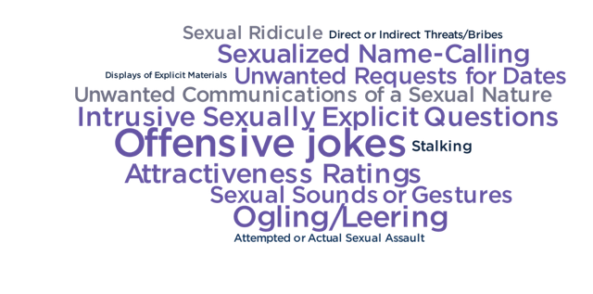
WLG Asked Respondents:
What have you experienced or observed?

Slide 9
Salient Findings
The extent and breadth of misconduct/harassment are insidious and alarming
Reporting systems often do not work – sometimes are harmful
Most harassers face few to no adverse consequences

Slide 10
Salient Findings
The “price” that women, in particular, pay and the cost to the profession are considerable
People at every level are being harassed – some are very powerful
Age, Race/Ethnicity, and Sexual Orientation/Gender Identity are compounding factors

Slide 11
Findings
“Even though this happened to me once when I was a law student, over 30 years ago, it still haunts me.”
1. The Extent and Breadth of Misconduct/ Harassment are Insidious and Alarming

Slide 12
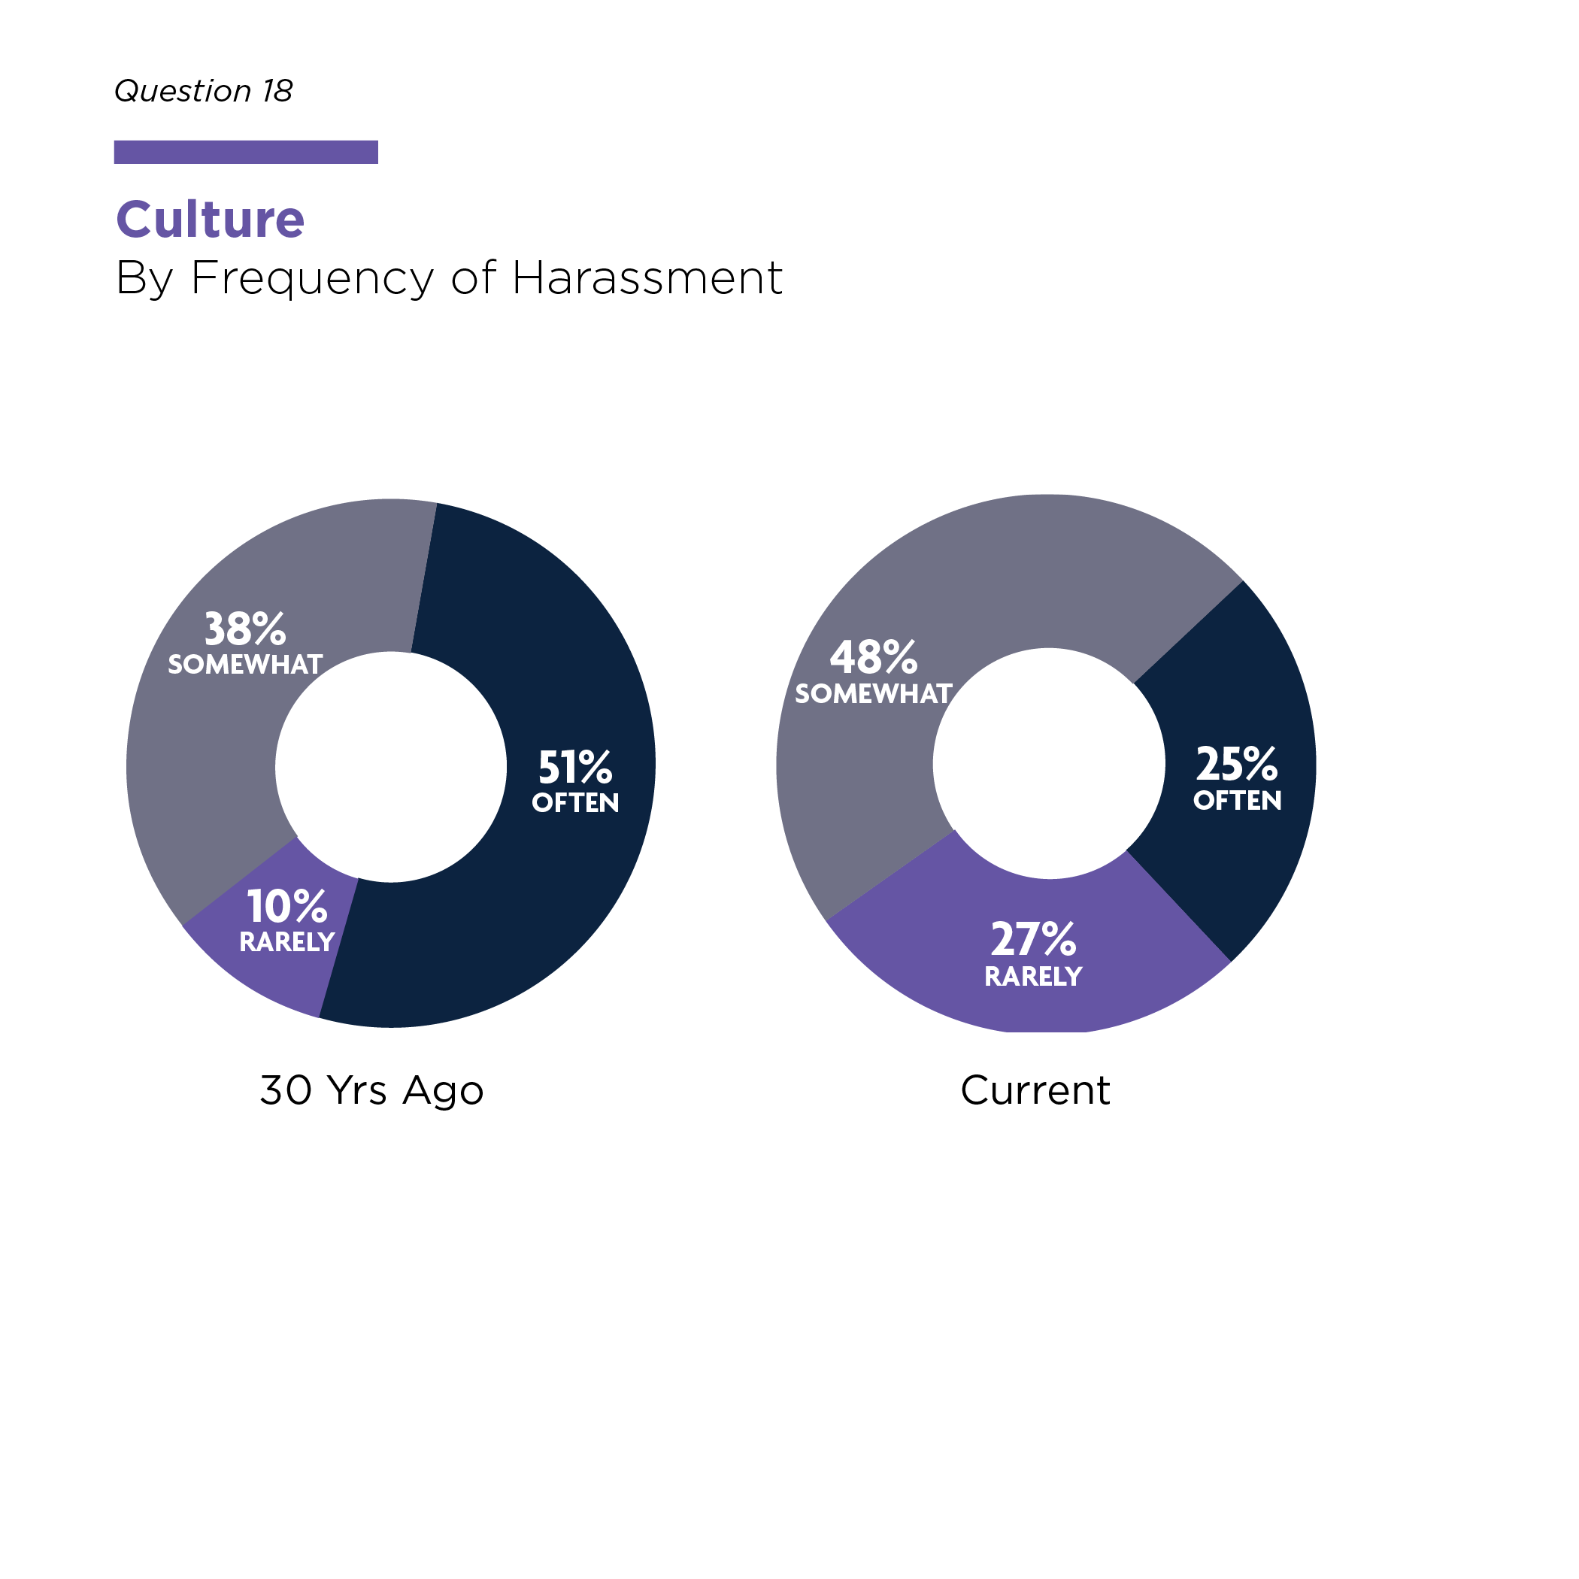
Unacceptable Cultures Prevail
Often, harassment is part of the employment setting’s culture

Slide 13
Who’s Doing the Harassing? People at every level of the legal profession

Slide 14
Myths about the Setting of Harassment
Harassment in group settings has increased

Slide 15
Findings
“For me, the reporting process did at least as much damage as the original rape.”
2. Reporting systems often do not work – sometimes are harmful

Slide 16
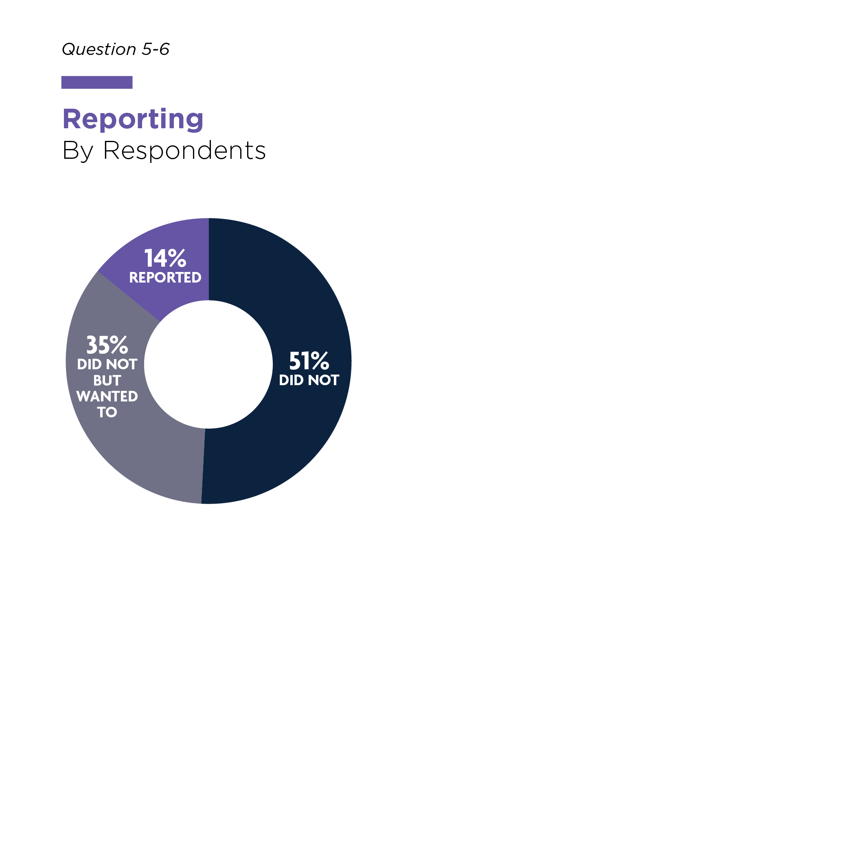
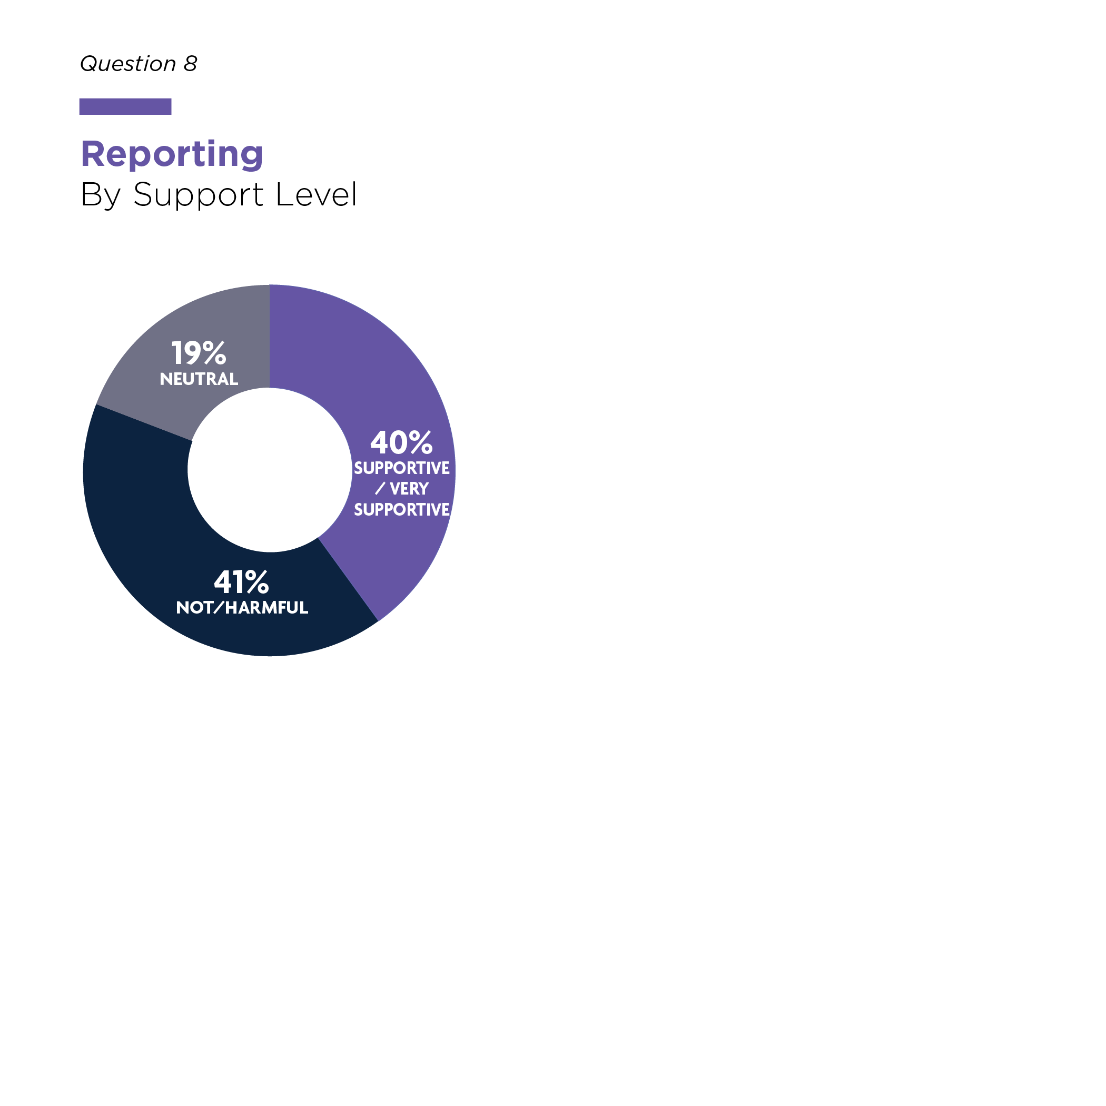
Reporting System Problems
Barriers to Reporting
Did they report/want to report?
Were they supported if they reported?
Current
Current

Slide 17
Findings
”Reporting sexual harassment ended my (big law firm) career. Nothing – ABSOLUTELY NOTHING – happened to my harasser…I eventually sued and my name was dragged through the mud further damaging my career.”
3. Most harassers face few to no adverse consequences after reporting

Slide 18
Findings
“I thought it was the price for being a successful female in a male dominated profession.”
4. The “price” that women, in particular, pay and the cost to the profession are considerable

Slide 19
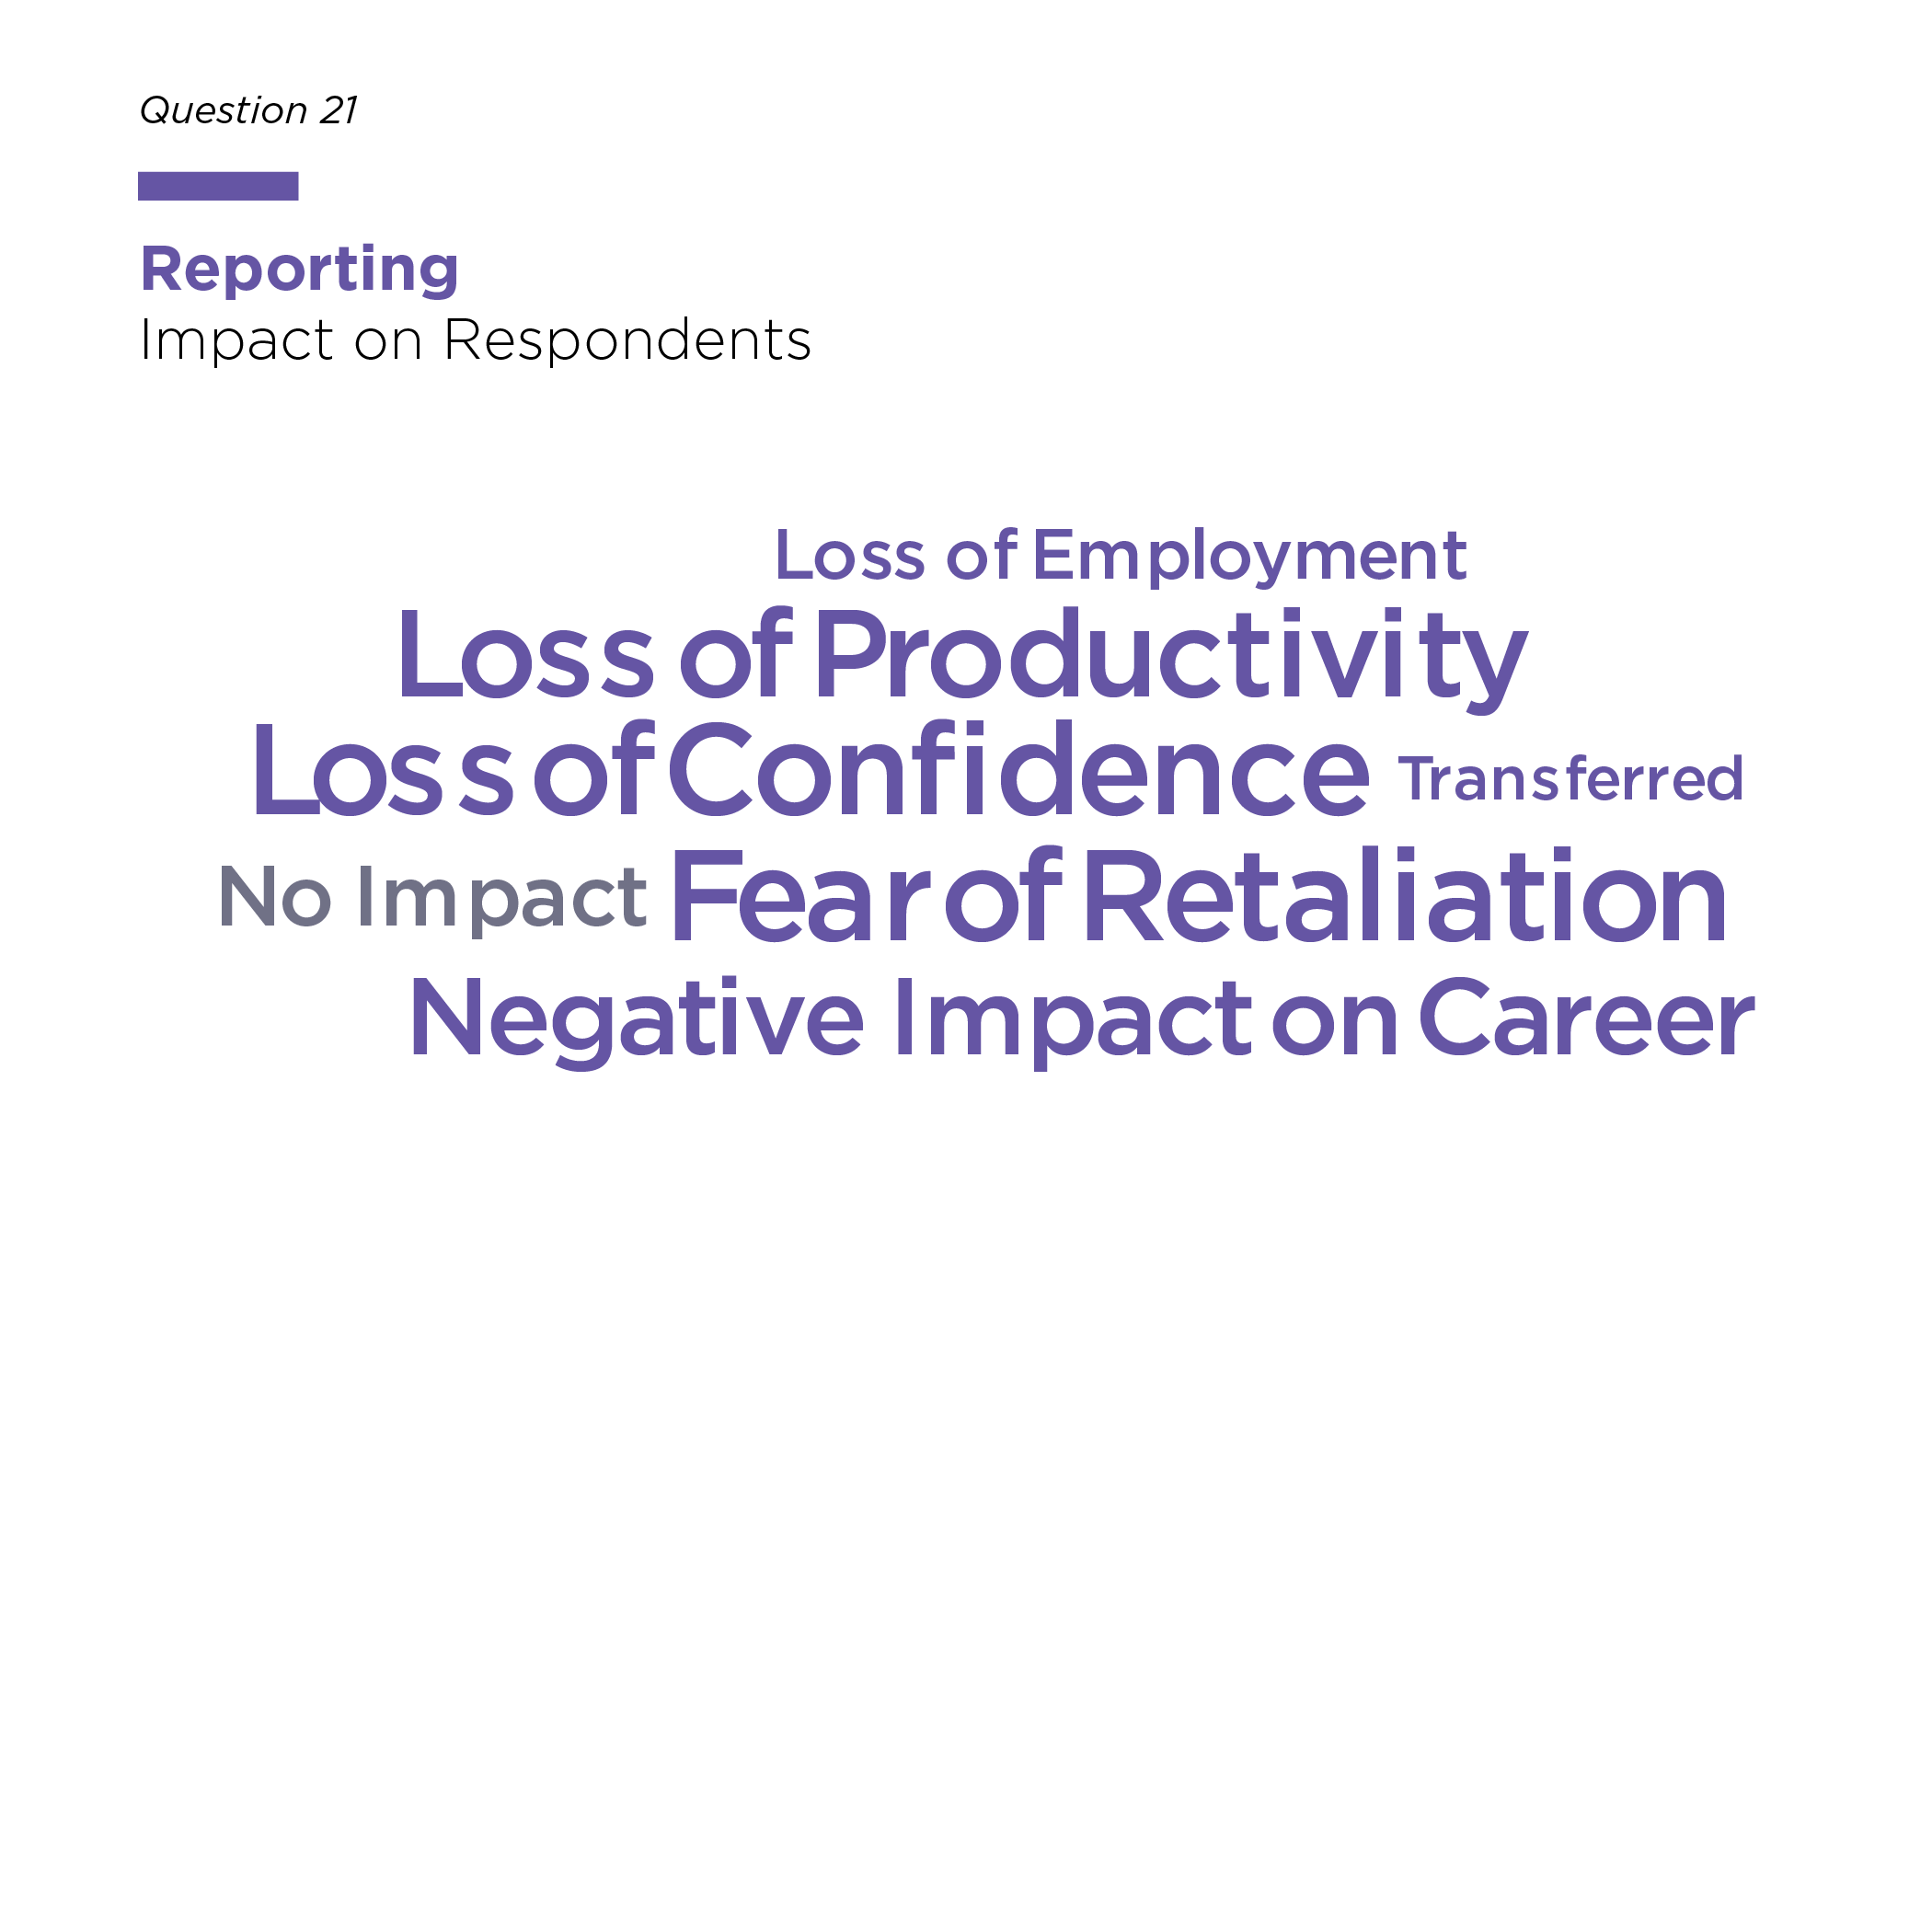
Impact on Respondents
Those who are harassed face much harsher consequences than those doing the harassing

Slide 20
Findings
“[I] was a member of the Judiciary and the harasser was an employee of a government agency…Having a position of authority didn’t matter – I still feared that reporting the incident would impact my chances for advancement…and label me as a ’problem,’…I still experienced anxiety about reporting.”
5. People at every level are being harassed – some very powerful people

Slide 21
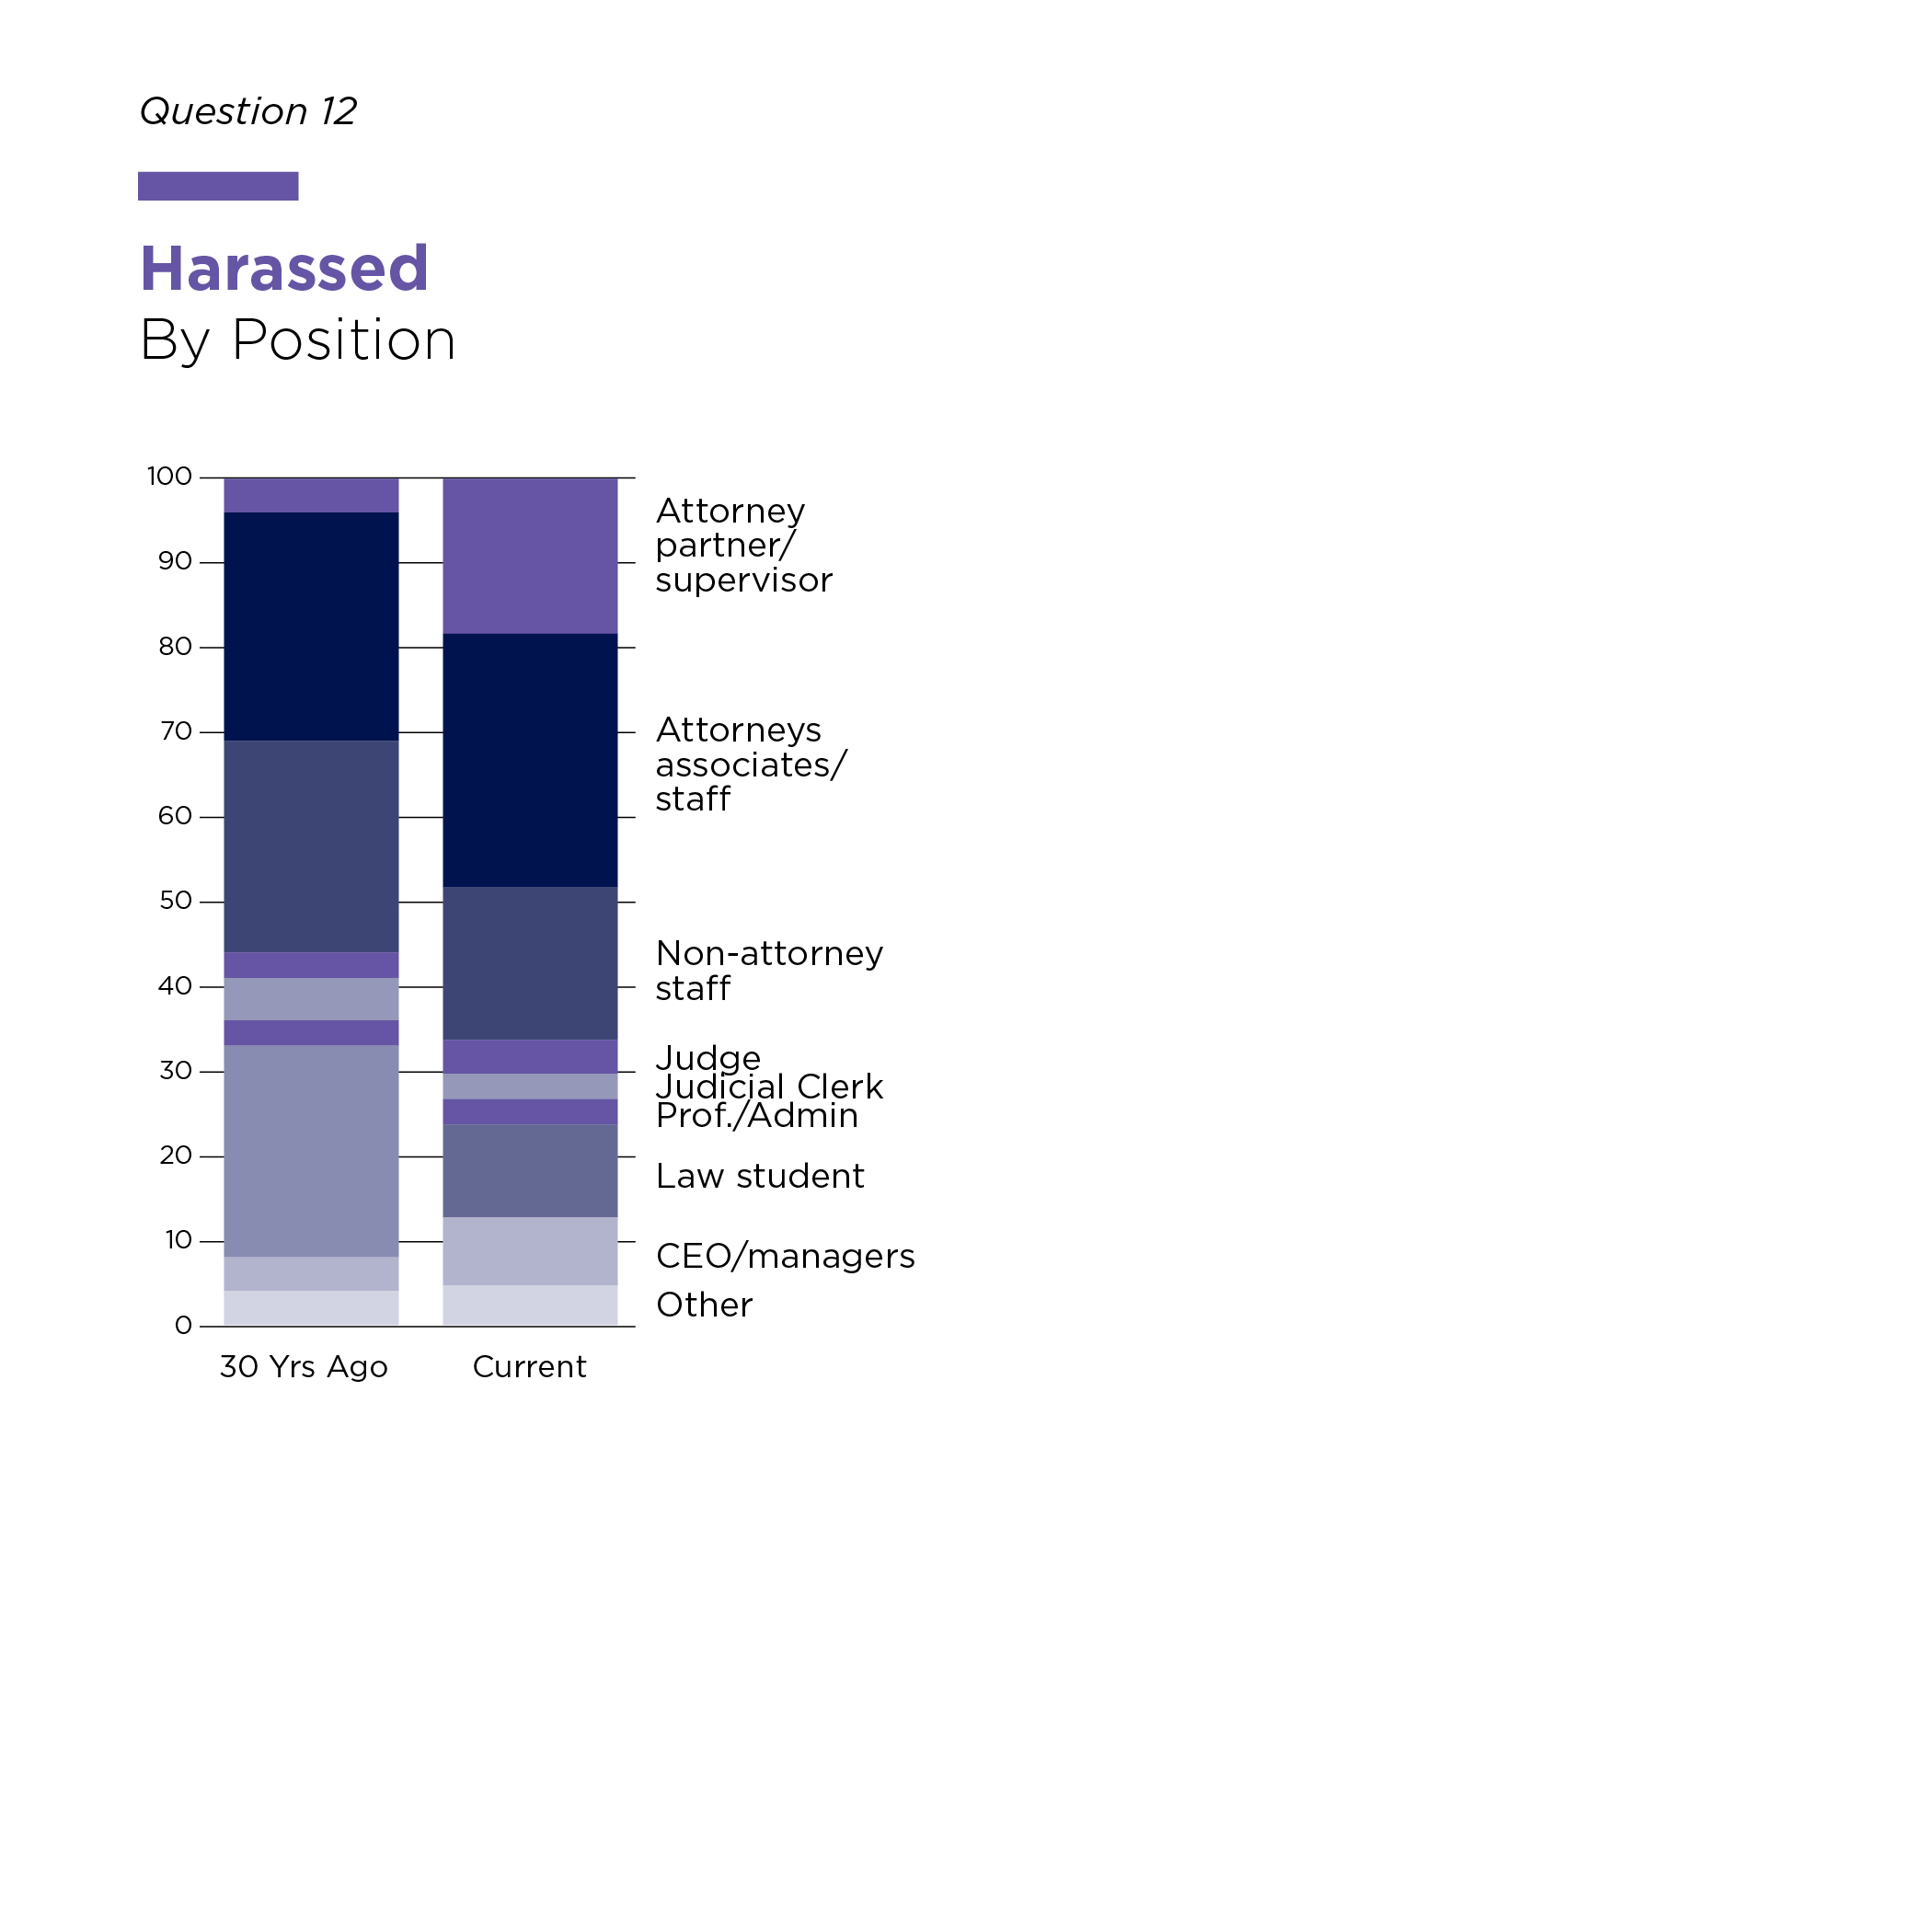
Who is Harassed?
People at every level of the profession are harassed

Slide 22
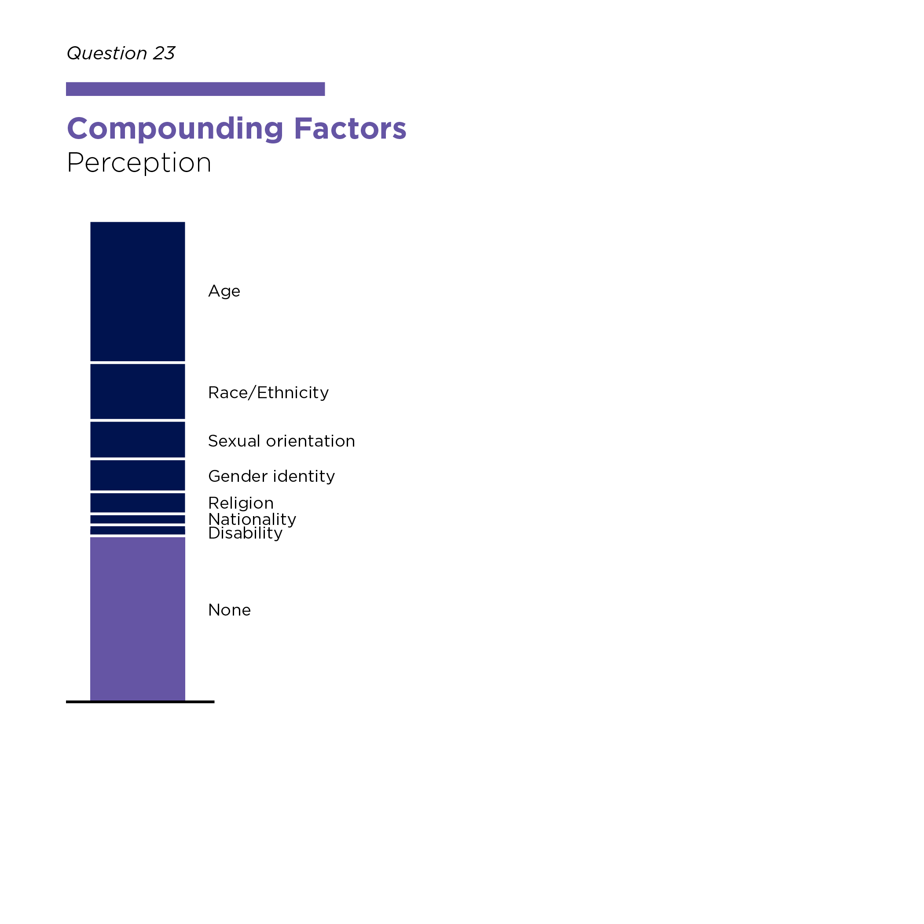
Findings
6. Intersectionality: Respondents report “compounding factors”
Age
Sexual orientation/gender identity
Race/ethnicity
Religion

Slide 23
Recommendations
Identify problem cultures
More tailored, effective strategies
Create concrete intervention tools
e.g. effective bystander intervention training
More effective accountability
e.g. Rules of Professional Conduct
Increased transparency

Slide 24
Recommendations
Support work on this issue at an early age
More options for independent investigations and reporting systems
e.g. Rules of Professional Conduct
e.g. Ombuds Reporting Systems
Seek better understanding through frank and nuanced conversations
Motivate active male allies

Slide 25
WLG Initiative on Sexual Harassment “Conversations With Men”

Slide 26
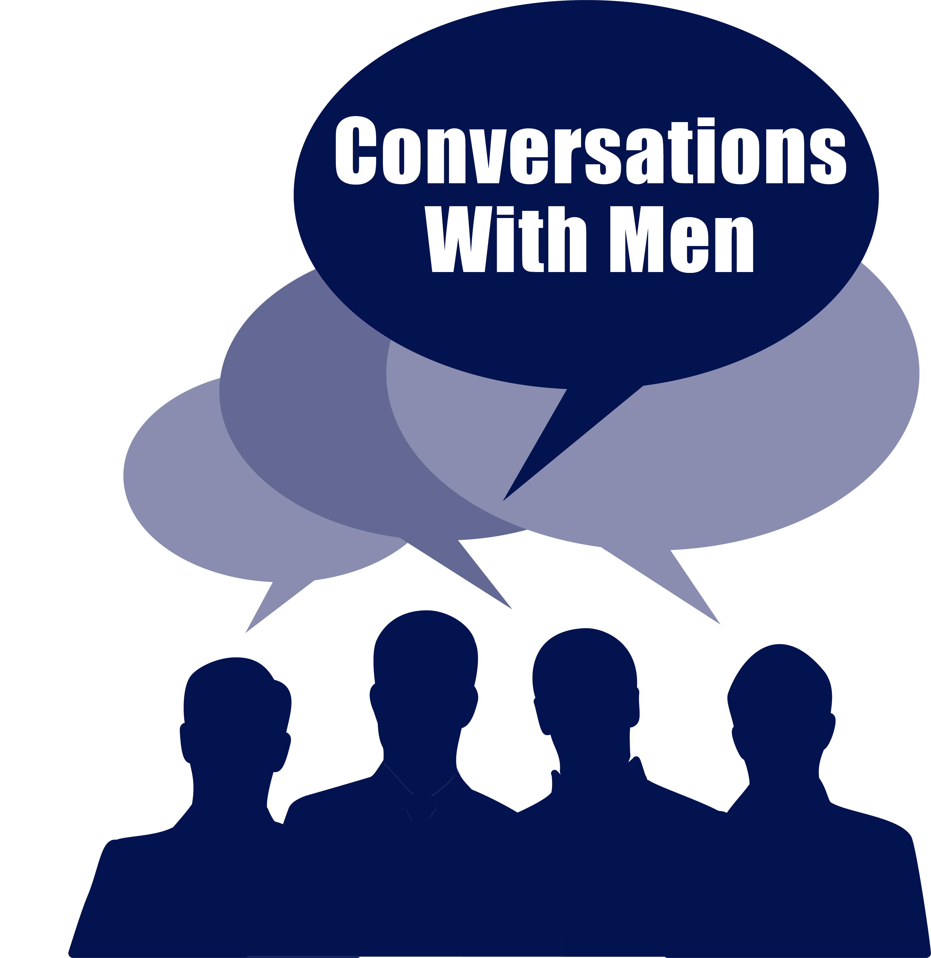
Conversations With Men™
Measures of Promise
Professionally facilitated small group frank discussions
Goals: develop deeper understanding, active male allies
Spontaneous request for more monthly meetings; meeting for over two years so far!

Slide 27
ADDITIONAL RESOURSES
Sexual Harassment in the Legal Profession
Women Lawyers On Guard Inc., Still Broken: Sexual Harassment and Misconduct in the Legal Profession, A National Study, 2020, https://womenlawyersonguard.org/still-broken/.
Lauren Stiller Rikleen, Massachusetts Bar Association, Survey of Workplace Conduct and Behaviors in Law Firms, 2018, https://wbawbf.org/sites/WBAR-PR1/files/WBA%20Survey%20of%20Workplace%20Conduct%20and%20Behaviors%20in%20Law%20Firms%20FINAL.pdf.
Kieran Pender, International Bar Association, Us Too? Bullying and Sexual Harassment in the Legal Profession, 2019.
Commission on Women in the Profession, Zero Tolerance: Best Practices for Combating Sex-Based Harassment in the Legal Profession, American Bar Association, 2018.
Sexual Harassment in General
Chai R. Feldblum and Victoria A. Lipnic, U.S. Equal Employment Opportunity Commission, Select Task Force on the Study of Harassment in the Workplace, June 2016, https://www.eeoc.gov/select-task-force-study-harassment-workplace.
The Purple Campaign, https://www.purplecampaign.org/ (corporate engagement, legislation and lobbying).
(Continued next slide)

Slide 28
“Ultimately, this is all about power and respect (or lack thereof) in the workplace…[T]he powerful still protect each other…there is still enormous pressure not to challenge the powerful. I believe that we still have a long way to go in terms of changing mindsets in the legal profession.”
“I never regret saying something. I always regret NOT saying something.

Slide 29
TAKE ACTION
SHARE both reports widely
www.womenlawyersonguard.org/still-broken/
www.womenlawyersonguard.org/conversationswithmen/
SUPPORT SCALING of WLG’s Conversations with Men
www.womenlawyersonguard.org/donate/
JOIN US www.womenlawyersonguard.org/join/
CONTACT US: camron@womenlawyersonguard.org

Slide 30
Sexual Harassment Why Do We Need a Rule of Professional Conduct?
The Practice of Law is a Self-Governing Profession: Lawyers counsel others about appropriate, ethical and legal behavior, including the drafting and application of sexual harassment and discrimination policies. How can the profession tolerate the same harassing behavior from lawyers?
Other “society-based” ills (like stealing and fraud) are addressed in the disciplinary rules. See, e.g. Model Rules of Professional Conduct 8.4(b) and 8.4 (c).
Sexual harassment of lawyers and discrimination against lawyers, by lawyers, is prejudicial to the administration of justice and the representation of clients. See, Model Rule 8.4 (d).

Slide 31
Sexual Harassment Why Utilize State Rules of Professional Conduct?
A primary purpose of the Rules of Professional Conduct is to deter misconduct.
There are many real-world barriers and negative consequences to reporting sexual harassment; the Model Rule provides an alternate reporting mechanism.
Sometimes no remedy is available within employment/partnership setting.
Mandatory arbitration clauses can be a barrier to reporting and addressing sexual harassment.

Slide 32
Sexual Harassment Why Utilize State Rules of Professional Conduct?
Certain small-firm employees can’t bring a suit against their employer under Federal law.
Situations such as sexual harassment by opposing counsel are difficult to address any other way.
This holds individuals responsible for their own behavior.
However, some attorney disciplinary systems may require “exhaustion” of other remedies first. E.g., AK’s Rule 8.4(f); NJ’s Rule 8.4(g) with respect to employment discrimination. See also, MN Rule 8.4(h)(2).

Slide 33
Utilizing Rules of Professional Conduct
ABA Model Rule 8.4 (g)
It is professional misconduct for a lawyer to: … (g) engage in conduct that the lawyer knows or reasonably should know is harassment or discrimination on the basis of race, sex, religion, national origin, ethnicity, disability, age, sexual orientation, gender identity, marital status or socioeconomic status in conduct related to the practice of law...
[Comments: …Sexual harassment incudes unwelcome sexual advances, requests for sexual favors and other unwelcome verbal or physical conduct of a sexual nature…..]

Slide 34
Rules of Professional Conduct and Comments
CHALLENGES to Utilizing Rule 8.4(g)
State Supreme Courts and bar associations which have considered but not adopted MR 8.4(g) have been primarily concerned about its breadth, the protection it provides to LGBTQ+ persons, and the possibility of false complaints.
In fact, MR 8.4(g) is limited to conduct related to the practice of law, LGBTQ+ persons are a protected class in many instances. Also there is no evidence that false complaints are more common under this Rule than with any other possible Rule violations.

Slide 35
Sexual Harassment Rule 8.4(g) is not the only Rule that may be implicated when a lawyer engages in sexual harassment.
Other Rules of Professional Conduct may be violated when an attorney engages in sexual harassment:
1.8(j) – Prohibits sexual relations with a client beginning after the client-lawyer relationship has commenced.
4.4(a) – When representing a client, “ a lawyer shall not use means that have no substantial purpose other than to embarrass, delay or burden a third person...” E.g., ID’s Rule 4.4(a)(1); MA Rule 4.4(a).
8.4(b) – It is professional misconduct to commit a criminal act that reflects adversely on the lawyer’s honesty, trustworthiness or fitness as a lawyer in other respects.
8.4(d) – Prof. misconduct to engage in conduct that is prejudicial to the administration of justice.

Slide 36
Rules of Professional Conduct and Comments
The most recent data from the ABA shows that at least 21 States have adopted language in their versions of Rule 8.4 prohibiting discrimination and/or harassment. E.g., AK, CA, CO, FL, HI, IL, IA, ME, MD, MN, MO, NE, NH, NM, NY, OR, PA, RI, VT, WA and WI. NY’s Rule is particularly good. VT has adopted MR 8.4(g).
Other states and licensing jurisdictions prohibit discrimination in other rules. E.g., DC (Rule 9.1), MA (Rule 4.4(a)), TX (Rule 5.06).
29 States have adopted Comments to their Rule 8.4 prohibiting prejudice and bias.

Slide 37
Both Before and After Model Rule 8.4(g) was Adopted, State Supreme Courts Have Sanctioned Lawyers for Engaging in Sexual Harassment
Examples:
Iowa Supreme Court Att’y Disciplinary Bd. V. Watkins, 994 N.W.2d 881 (Iowa 2020) (county attorney’s sexual harassment of female subordinates for two years constituted “textbook examples of what not to do in the workplace”)(Sanction: Suspended indefinitely; no possibility of reinstatement for 6 mos. following date of this decision.)
Lawyer Disciplinary Bd. v. Hatfield, 852 S.E.2d 785 (W. Va. 2020) (attempting to have client pay for representation with sex; violated Rules 8.4(a), (b) and (d)). (Sanction: Atty. disbarred (“law license annulled”) and ordered to pay costs of the proceedings.)

Slide 38
Both Before and After Model Rule 8.4(g) was Adopted, State Supreme Courts Have Sanctioned Lawyers for Engaging in Sexual Harassment
Examples:
In re Kennedy, 946 N.W.2d 568 (Minn. 2020) (bartering with client for sexual favors) (Sanction: Indefinite suspension; cannot petition for reinstatement for 2 yrs.; must pay costs of the proceeding; must meet other conditions for reinstatement.)
In re Robinson, 209 A.3d 570 (Vt. 2019) (Lawyer sexually harassed employee and pressured her to sign agreement not to file harassment claims) (Sanction: Atty. disbarred.)

Slide 39
Both Before and After Model Rule 8.4(g) was Adopted, State Supreme Courts Have Sanctioned Lawyers for Engaging in Sexual Harassment
Examples:
In re Phillips, 408 P.3d 942 (Kan. 2018) (lawyer asked prospective client not to wear “under panties” to appointment with him) (Sanction: One yr. suspension; subject to hearing upon request for reinstatement; payment of costs of the proceeding.)
In re Baratki, 902 N.W.2d 250 (Wis. 2017) (sexually harassing client, through text messages and physical contact) (Sanction: Six month suspension.)

Slide 40
Both Before and After Model Rule 8.4(g) was Adopted, State Supreme Courts Have Sanctioned Lawyers for Engaging in Sexual Harassment
Examples:
In re Kratz, 851 N.W.2d 219 (Wis. 2014) (prosecutor sent sexually harassing text messages to domestic abuse victim and made sexually harassing comments to witness in another case; Wis. Rule 8.4(i) violation) Sanction: Four month suspension; payment of costs of the proceeding.)
Courtney v. Alabama State Bar, 492 So.2d 1002 (Ala. 1986) (unwanted sexual advances toward client’s guardian) (Sanction: Atty. received public censure.)

Slide 41
Questions?

